Slide 1
Introduction to EMBASE on Ovid
EMBASE is a key resource for generating systematic reviews and supporting effective evidence-based medicine and drug and medical device searching
Notes:
Welcome to this short presentation on EMBASE on Ovid

Slide 2
EMBASE Facts
Extensive EMTREE thesaurus structure with many synonyms used in mapping and Thesaurus displays include numbers of records
Guided mapping and searching with easy access to all EMTREE thesaurus displays, including drug and disease subheading roles
Clearer thesaurus (plain English, not inverted)
Comprehensive early coverage of pharmaceuticals during drug development stages and clinical trials
Easy to use interface, easy workflow – subjects, subheadings, limits integrated together
Better “Rest of the World” journal coverage
Searching multi-database with no loss of functionality and alerts with deduplication
McMaster Clinical Queries
Natural Language searching
Full text linking
Notes:
Here are the characteristics of the EMBASE database on Ovid. The database offers easy access to the EMTREE thesaurus and it’s subheadings and limits using the thesaurus tools and limits. It also offers access to other ways of searching the database, using keywords or specific fields.

Slide 3
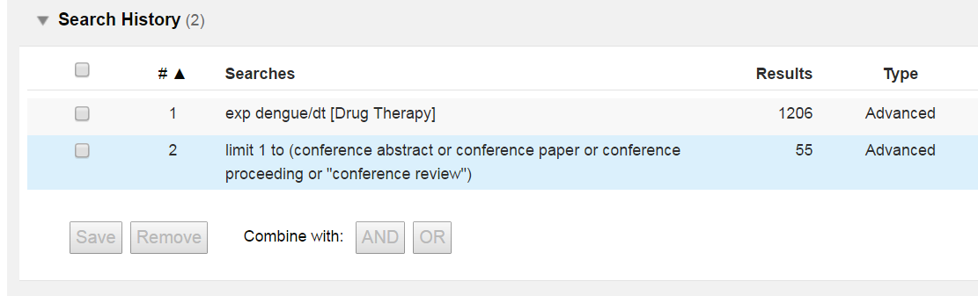
Introduction to EMBASE on Ovid
Special subjects, fields and subheadings for disease, drug or medical device searching
  Disease, drug and device subheadings
  Drug & Device trade name
  Drug & Device manufacturer
  CAS registry number
Important database specific limits
  Clinical Trial limits to refine results to records on clinical trials or a certain phase of drug development
  Methodologies limit including Meta analysis and Systematic Review
  Additional document types including conferences
Notes:
The database has a special focus on diseases, drugs and devices and non journal publications, which are offered as part of the software as a part of mapping and other access points.

Slide 4
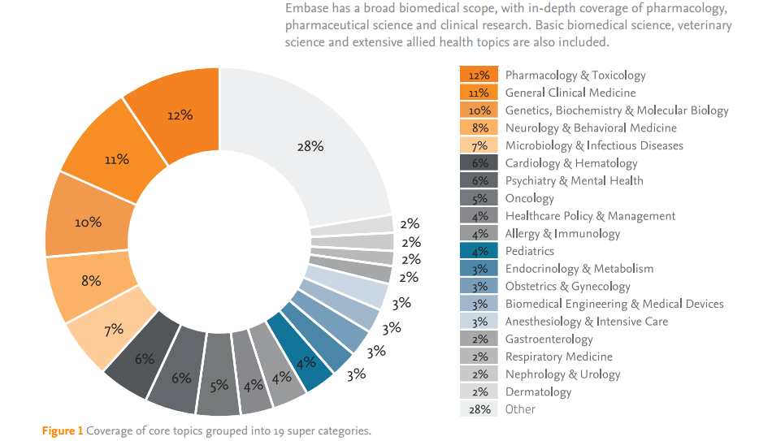
EMBASE Scope and Content
The focus of the database has greatly expanded due to the addition of all MEDLINE records
Notes:
Here is a visual representation of the content of EMBASE taken from an EMBASE publication. The traditional coverage of the EMBASE database emphasised drugs and chemicals, and including drug development, medical devices and many other biomedical topics. But this coverage was expanded when all the records which are available in the MEDLINE were also included in EMBASE.

Slide 5
EMTREE Thesaurus
The EMTREE thesaurus is an easy to use and comprehensive subject guide with an emphasis on drugs and chemicals and on diseases and health problems. It is different to MEDLINE’s MeSH in many ways – it uses "plain English" not inverted terms, and it often uses singular rather than plural forms, even for multiple items, groups and categories. Even similar terms may vary from MeSH terms in the level of detail and position in the subject hierarchy.
As of January 2016, EMTREE contains:
Over 73,000 preferred terms (more than 31,000 for drugs and chemicals)
Over 310,000 synonyms (more than 190,000 for drugs and chemicals)
Over 3,000 specific terms for general and medical devices (e.g., endoscopes, catheters, prostheses)
Several thousand terms for related medical procedures (e.g., endoscopy, catheterization)
64 drug subheadings, including 47 routes of administration
4 medical device subheadings
14 disease subheadings
38 check tags for study types, including randomized controlled trial, systematic review, and diagnostic test accuracy study
Access to over 23,000 CAS registry numbers
Notes:
Many of the Elsevier databases and products use the EMTREE thesaurus, including EMBASE. The EMTREE thesaurus which is an easy to use and comprehensive subject guide with an emphasis on drugs and chemicals and on diseases and health problems. Coverage of drug and chemical terms begins early in development, offering access to early trials and also to conferences and meetings for early publications. There is broad coverage of journals including all MEDLINE journal coverage plus over 2,500 additional journals - including journals in languages other than English.
Almost half the terms are about drugs and chemicals – a real drug may be any chemical that can affect metabolism, not just what we think of as drugs. The check tags or the EMTREE terms may be offered as limits.

Slide 6
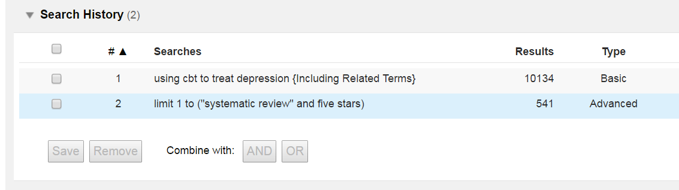
Using EMBASE on Ovid
Ovid offers a wide variety of search modes which will suit both an experienced researcher or a beginner
Search for whole topics or questions using Basic Search
Search for subjects interactively using Advanced Search
Search combinations of fields and subjects with Multi-Field Searching
Find or check references with Find Citation
Explore the subject structure of the EMTREE Thesaurus with Search Tools
Browse or search one, more or all fields with Search Fields
Notes:
Ovid offers a wide variety of access points into a database which will suit either an experienced researcher or a beginner… Let’s look at some examples.
Basic Search is a quick relevance ranked search option, not an exhaustive search across the entire database. Basis Search is useful for inexperienced searchers, and also for new or unfamiliar subjects
The subjects list in Results Tools provides an insight into which subjects are most common in the sample of records (after limiting to 4 or 5 star relevance)

Slide 7
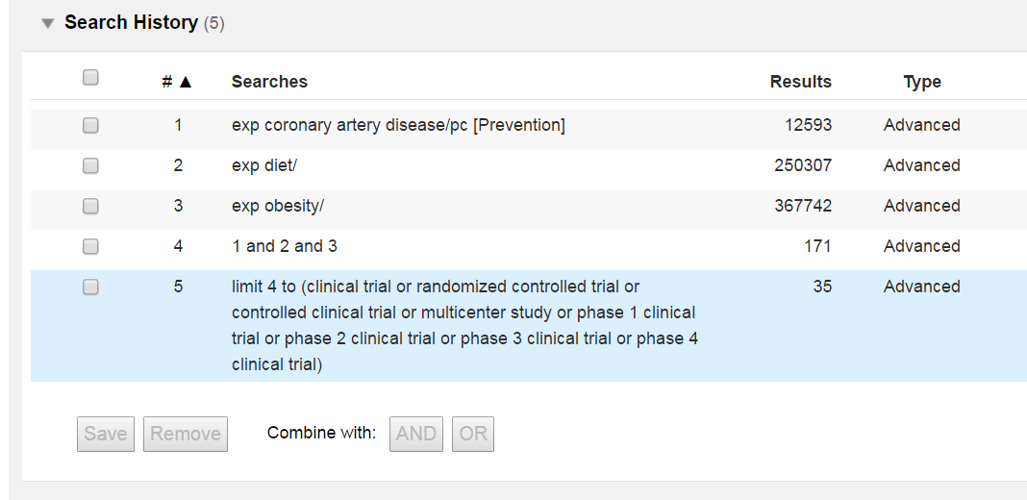
Advanced Search
Advanced Search is an interactive research style search offering:
Mapping to subject headings (EMTREE) and to subheadings (drug, device and disease subheadings) for drug and disease topics
Keyword searching (.mp.) including title, abstract, subject headings & other drug and device subject fields
Author searching (interactive)
Title searching (words or phrases)
Journal searching (interactive)
Notes:
In Advanced Search mode Mapping translates your words and phrases and refers them to subjects within EMTREE, further details on the mapping process follows. Advanced mode also provides access to keyword searching, author name and journal name searches and searches within the title.

Slide 8
Mapping
Entering an exact match for an EMTREE term in the controlled vocabulary; the term will appear and be selected, but other similar subjects will be listed (often a prompt to choose “explode”)
e.g. coughing
Entering a synonym for a term, will direct you to the EMTREE term (“explode” if a category or group of subjects) – EMTREE to MeSH translation for example
e.g. aspirin > acetylsalicylic acid
No match – Frequency based listing If term is neither a direct match nor listed as a "used for" term ("see” reference or synonym) then:
  Ovid looks at citation where terms occurs in title or abstract or other fields…
  Algorithm counts the occurrence of subject headings tied to those citations.
  The most frequently occurring subject headings are presented to the user as choices. Selected database segment selected is the sample.
  In a frequency based list, one choice may be appropriate, or more than one, or a combination of choices, or you may choose to “search as a keyword”
  e.g. cholera vaccination
“Cannot map term to a subject heading” – check spelling, or “search as a keyword” if very new or rare, this is an less usual response for a large database
All EMTREE terms have an equivalent MeSH term (in the scope note), but the term may not be at the same level or be associated with the same definition or have the same narrower terms
Notes:
There are four types of mapping response – Mapping translates plain English requests to controlled vocabulary terms
Mapping provides access to a database’s own thesaurus (in this case EMTREE), using information provided by the database – by matching, synonyms or subject relationships.
All MeSH terms (where available) are included as EMTREE synonyms in the scope notes
It also shows the user how many hits exist for their term as they search or browse.

Slide 9
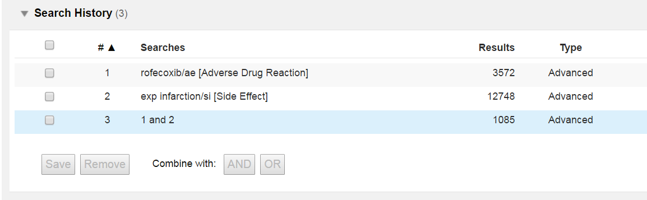
Subheadings
Disease Subheadings from 1988 (or later)
eg complication, diagnosis, drug therapy, epidemiology, etiology, prevention, side effect, surgery, therapy etc
Drug Subheadings from 1988 (or later)
eg. Adverse drug reaction , Clinical trial, Drug administration, Drug combination, Drug comparison, Drug development, Drug dose, Drug interaction , Drug therapy , Drug toxicity, Pharmacokinetics, Pharmacology etc
Route of Drug Administration Subheadings from 2000
eg. Buccal drug administration, Epidural drug administration, Inhalational drug administration, Intraarterial drug administration, Intrabronchial drug administration, Intracardiac drug administration, Intracavernous drug administration etc
Device Subheadings from 2012
eg adverse device effect, device comparison, device economics etc
Notes:
Subheadings are different in MEDLINE and EMBASE, a small number are the same, some use the same code but the majority have a different meaning and some are unique to each database. Subheadings give a subject a role or context. In EMBASE subheadings are primarily concerned with drugs and diseases, they were originally called drug and disease links.

Slide 10
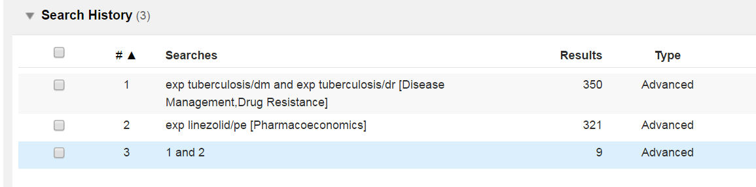
Subheadings
Subheadings are often paired in practice – “adverse drug reaction” and “side effect” for example
Subheading Exceptions
Disease subheadings all from 1988 except:
drug resistance – 1996
disease management - 1997
Drug subheadings all from 1988 except:
endogenous compound – 1991,
pharmaceutics – 1991
pharmacoeconomics – 1997
Notes:
Most Drug and Disease subheadings date from 1988, apart from these exceptions. Drug Administration subheadings all begin in the year 2000.

Slide 11
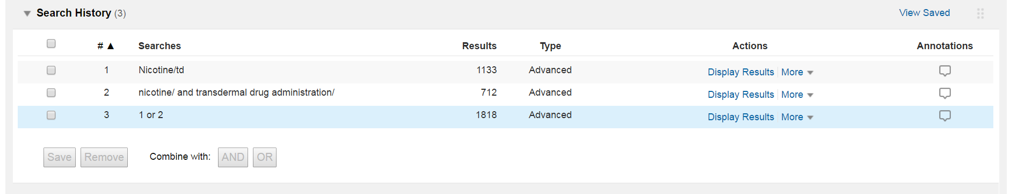
Advanced Search including Subheadings
Because the subheadings are only available in the database since 1988, applying a subheading limits a search to a period of time, as well as a subject*
To perform a search for a subject/subheading combination retrospectively, use a subject/subheading and OR the corresponding subject/subject pair (and possible synonyms)
Nicotine/td or (nicotine/ and transdermal drug administration/)
* Added MEDLINE records and retrospective indexing are exceptions.
Notes:
An unintended effect of selecting a subject/subheading pair is that you may be limiting to a period of time. Note too that in some cases subjects as well as subheadings in EMTREE may be more recent than 1988 - check the subject scope note for further information. To perform a retrospective search, you may need to include a subject subheading pair and add a subject subject pair as well to cover the period before 1988. This may make the result less precise.

Slide 12
Triple Subheadings
Adding to the subheading role
When we search in EMBASE on Ovid at the moment, we can find subject and subheading combinations. Sometimes we can assume that one is a cause and the other an effect, or that they are connected, this is the point of the new field in EMBASE, it will allow you to see groups of connected subjects. Triple subheadings only use key subheadings.
e.g. fentanyl/drug therapy/abdominal pain
Notes:
Here we are looking at one of the newly added fields, the triple subheading field. When we search in EMBASE or many other databases, we can find subject and subheading combinations. Sometimes we can assume that one is a cause and the other an effect, or that they are connected. This is the point of the new field in EMBASE, it will allow you to see groups of connected subjects. So, for example we may find a drug that is producing an adverse effect and the name of the side effect. Triple indexing is the three level indexing of the full text of the article – it consists of a primary subject (often a drug, device or disease), a key subheading which connects the two subjects and a secondary subject. Triple Indexing (“triples”) Examples:
Drug therapy: when this subheading is indexed, the diseases treated are also indexed with the disease subheading drug therapy.
Drug therapy: when this subheading is indexed, the drugs used to treat the indexed disease are also indexed with drug subheading drug therapy.
Adverse device effect: when this subheading is indexed, the adverse effects are also indexed when possible with the disease subheading complication

Slide 13
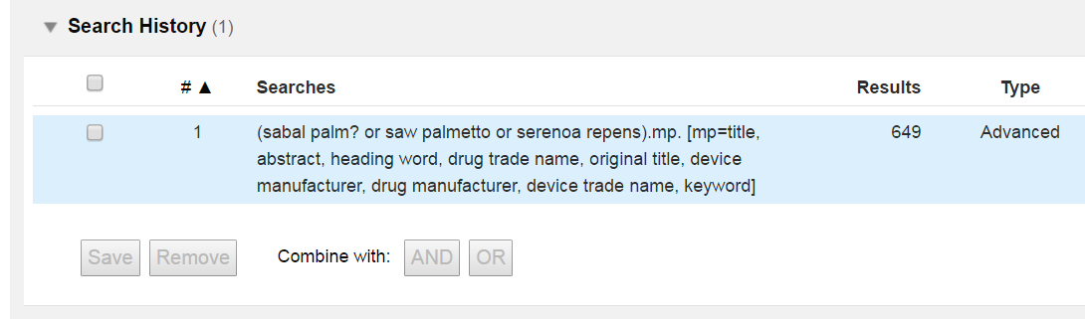
Advanced Search – Keyword Searching
Because you sometimes want to search outside the EMTREE thesaurus terms, it is possible to untick the mapping tool, it’s also possible to select “search as a keyword from within the mapping process.
Selecting either of these options will search across a group of fields which represent subjects, and include the title and abstract provided by the author and other subject fields from the database.
In EMBASE these include:
mp=title, abstract, subject headings, heading word, drug trade name, original title, device manufacturer, drug manufacturer, device trade name, keyword
Notes:
Some subjects aren’t available within the EMTREE thesaurus, or may only be available for a limited period of time. Or you may want to expand the scope of the search to include the author’s own words or other professional vocabularies.
When I turn off the mapping tool, or select “search as a keyword” as part of that process, I will search a group of subject fields, which always include the title and the abstract (as well as others selected for the specific database). Use keywords as part of a search strategy to search before the addition of the EMTREE subject heading, or to broaden the search result, or to include more MEDLINE records (which are automatically indexed and may have limited numbers of subject headings).

Slide 14
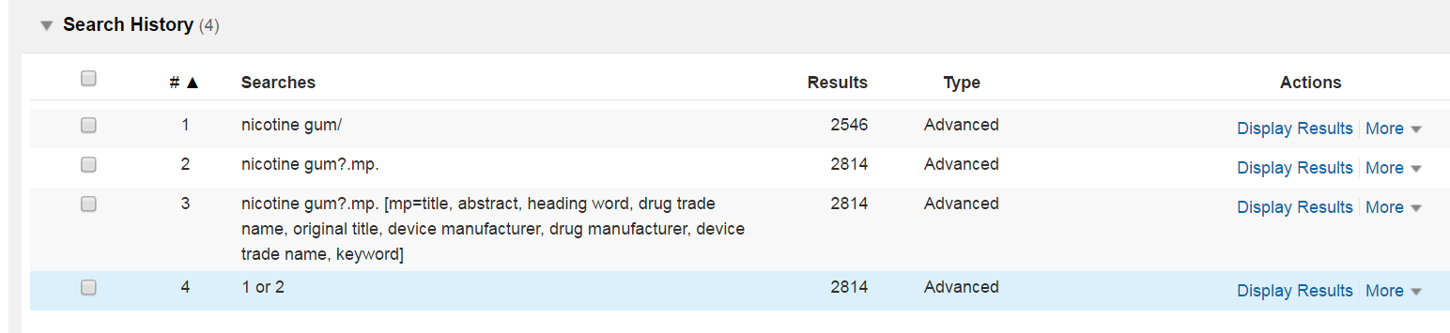
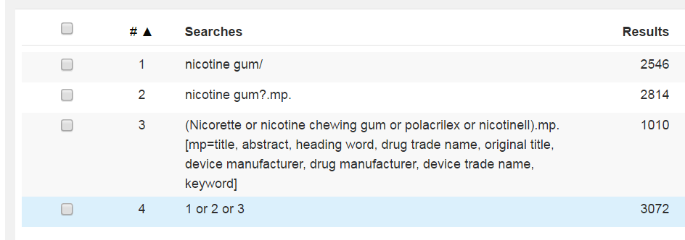
Advanced Search – Keywords
When searching with keywords, use all synonyms, and include truncation and wildcards to disguise singular and plural and spelling variants. Use as many synonyms as possible since often you are trying to match with the author’s words.
Notes:
When searching with keywords, use all synonyms, and include truncation and wildcards to disguise singular and plural and spelling variants. Use as many synonyms as possible since you are trying to match with the author’s words.

Slide 15
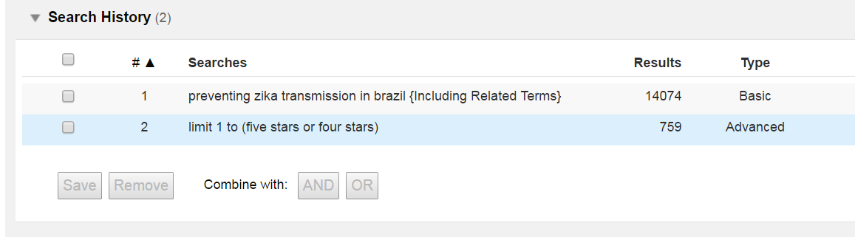
Basic Search
The purpose of Basic Search is to provide a useful number of highly relevant documents drawn from the most recent part of the database
Add related terms to include plurals and synonyms from the Ovid lexicon (often including MeSH)
Offers most relevant ranked results first (not most recent)
Can be limited (to Year or Full Text for example)
Note: Use Sorting option or year limit to select recent publications
Notes:
Basic Search is a quick relevance ranked search option, not an exhaustive search across the entire database. Basis Search is useful for inexperienced searchers, and also for new or unfamiliar subjects
The subjects list in Results Tools provides an insight into which subjects are most common in the sample of records (after limiting to 4 or 5 star relevance)

Slide 16
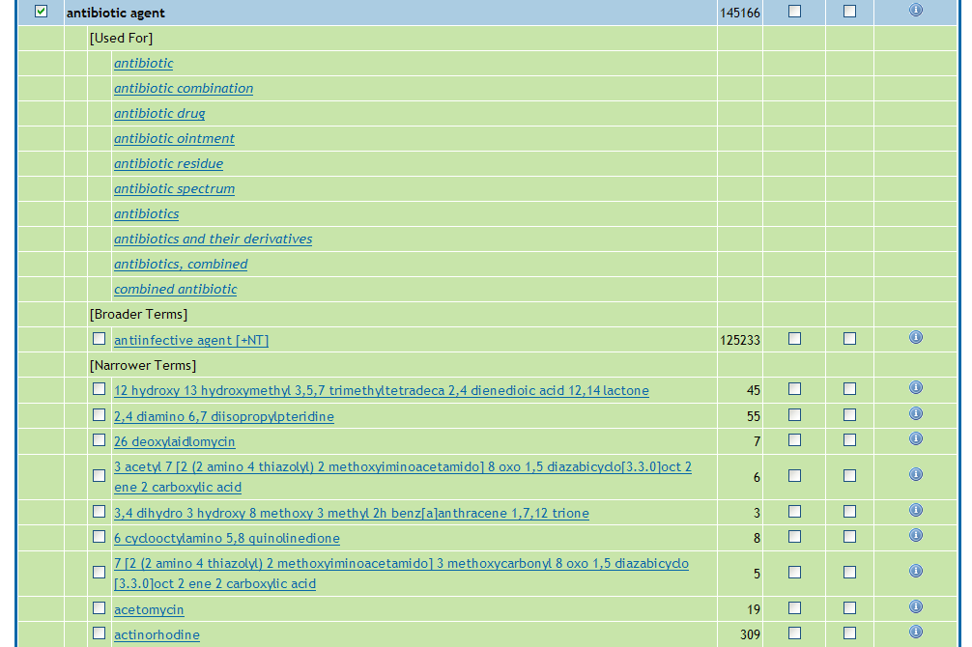
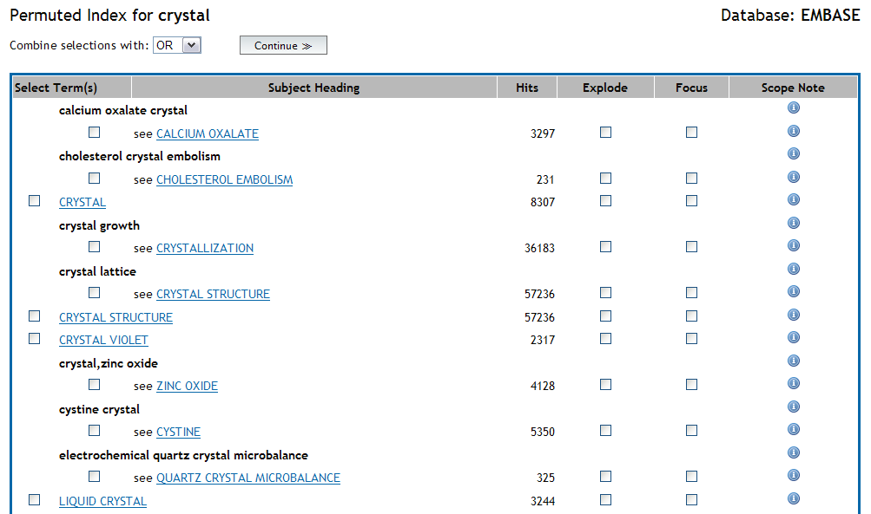
Search Tools
The Search Tools menu offers different ways of selecting subjects from the database subject structure
Mapping – suggesting subjects from the thesaurus
Tree – displaying the subject structure
Permuted Index – variations on a single word or theme
Subheadings – what subheadings are available
Explode – searches a subject and all of it’s parts or types
Notes:
Search Tools is a way of exploring the subject structure of the database – in this case EMTREE. All the Search Tools are also available in Advanced Mode as a part of mapping, except for the Permuted Index (and the classifications in other databases).

Slide 17
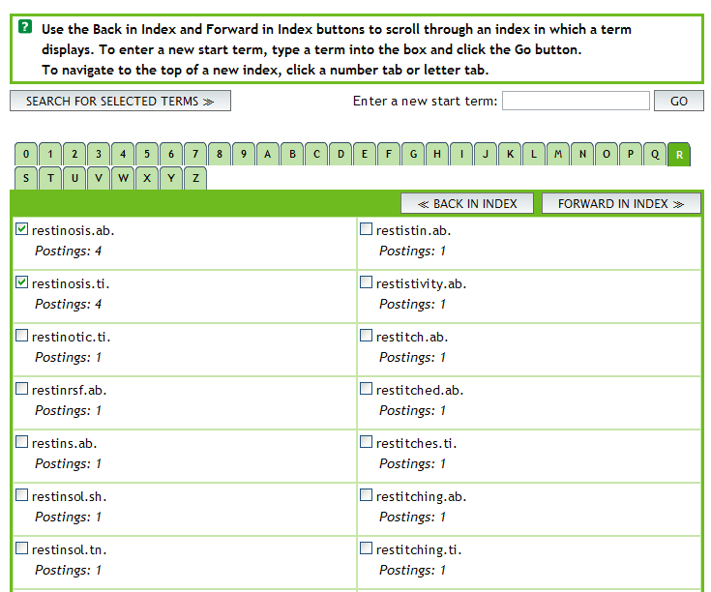
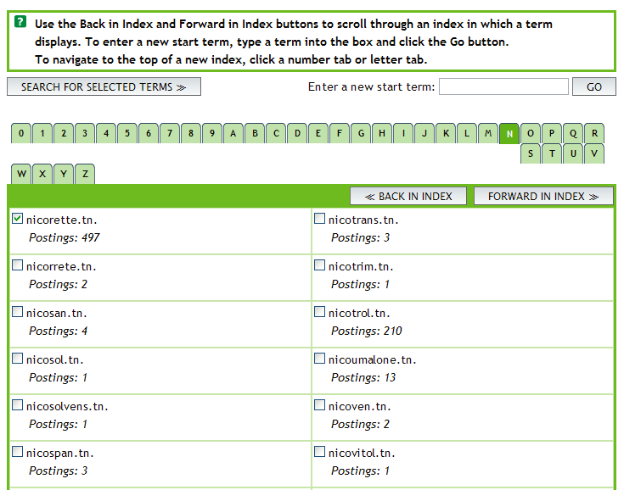
Search Fields
Search Fields searching or browsing across one or more (or All) fields within a database
Display Indexes to select from a list of choices
Choose Search to search without browsing
Clear Selections to make different field choices
Notes:
Use Search Fields to locate rare or unusual topics across all of the indexes, or to look inside individual fields – drug trade name, device trade name or conference details for example.

Slide 18
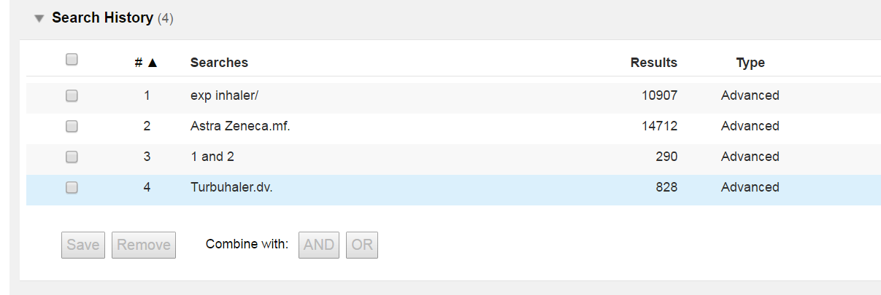
Fields of Note
CAS Registry Number – a number specific to individual chemical. Salts and variants may take a different number (includes a checksum)
Drug Trade Name – only used where that specific brand or dose form is important
Drug Manufacturer Name – for competitive information or disambiguation
Device Name – for medical devices
Device Manufacturer Name
Institution – academic institution or company name
Notes:
Because these fields are very specific, they can be used to create specific searches.
CAS Registry Number
Drug Trade Name
Drug Manufacturer Name
Device Name
Device Manufacturer Name

Slide 19
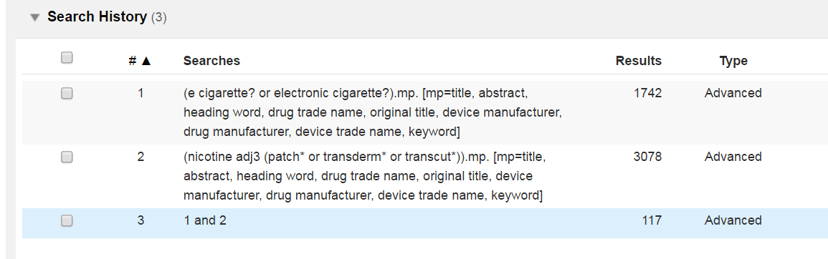
What searching tools are available ?
Combining
AND – both (or all) terms present
OR – either (or both) terms present
NOT – removes a term
ADJ# - ADJ6 within six words
Truncation
* or $ - unlimited characters at the end of a word
*6 or $6 – six characters after a word
? – one or zero characters at the end of or within a word
# - one variable character within a word
Notes:
For people using a mode other than Basic Search, here are the operators and truncation/wildcard symbols which can be used to broaden a search result to include variations in spelling, singular or plurals and presence within a sentence or paragraph. Note that when you search for a phrase in Ovid, you are generally searching for a specific phrase.
ADJ# is used as a substitute for searching within a sentence or paragraph which may be called NEAR or SAME or WITH in other search tools.

Slide 20
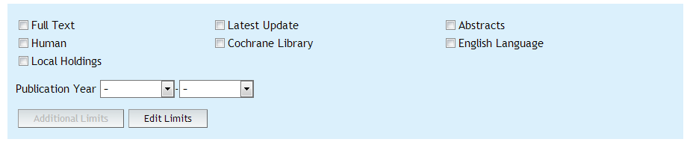

Limits
Two Types:
Commonly used limits – publication year, abstract, full text
Additional Limits
  Broad subject areas – clinical queries
  Languages (most English language)
  Types of publication – review, book, conference paper
    Clinical Trials and Evidence Based Medicine
  Parts of the population – age groups, gender
  Special database subjects –
    experimental subjects, routes of drug administration
Notes:
There are two types of limits, commonly used and more specific limits on the Additional Limits page. Others include parts of the population, types of documents and special subjects within the database.

Slide 21
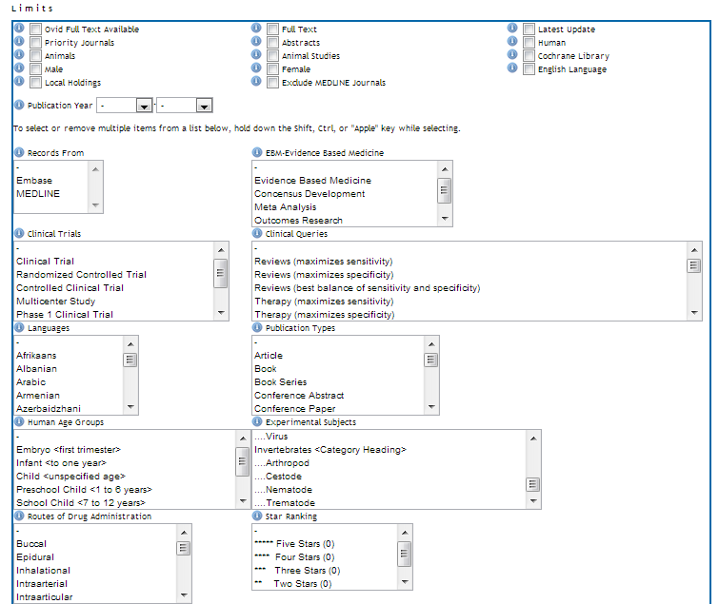

Limits
Notes:
The Additional Limits page is often about parts of the population, types of publications and documents etc. For publication types you may need to pick more than once to include publication types, clinical trials and evidence based medicine limit types.

Slide 22
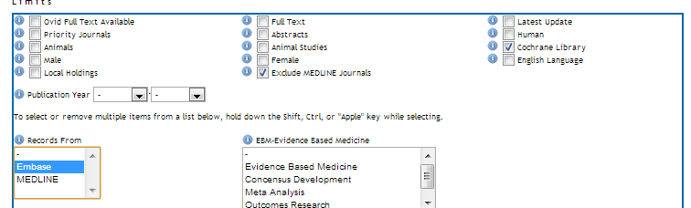
EMBASE specific Limits
Priority Journals – fast track indexing
Human, Animals and Animal Studies
Records From MEDLINE or EMBASE: To distinguish records coming from MEDLINE or native EMBASE records. Based on the Copyright field
Exclude MEDLINE Journals (EMBASE Unique) based on a journals list
Notes:
Limits about the content of EMBASE and where they originate or other relationships.

Slide 23
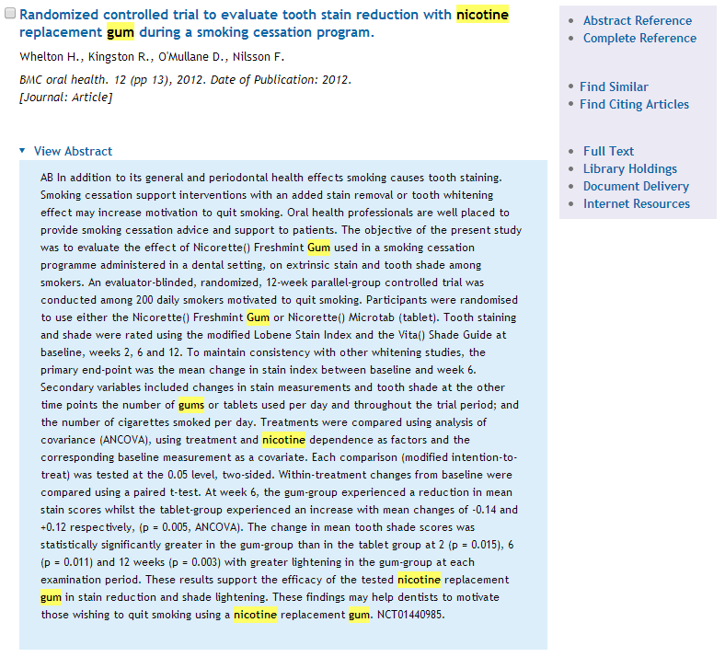
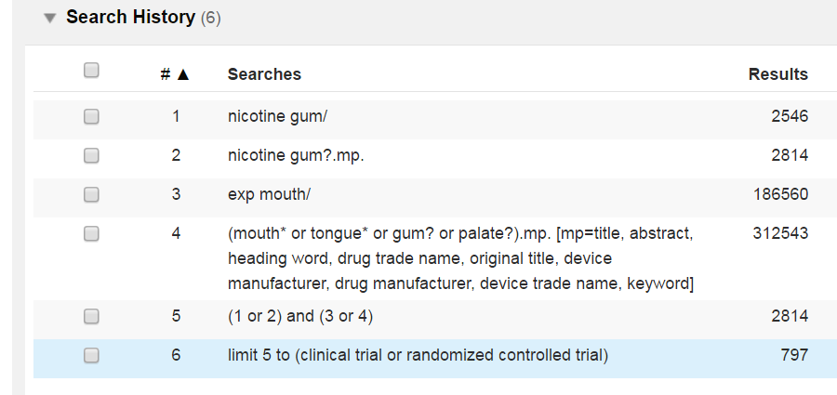
Putting it together to create a search
Usually a search will consist of several steps, including subject heading searches, keyword searches, combinations and some limits, and then a saving or output step.
Notes:
Often a search session would consist of several searching steps, including some keyword searches, a combination and some limits, then a saving or output step.

Slide 24
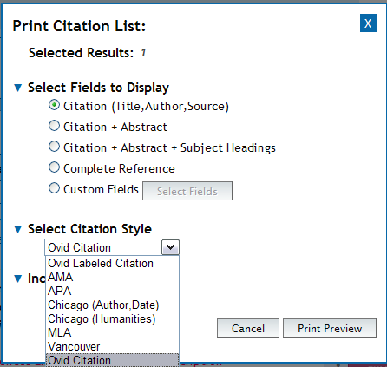
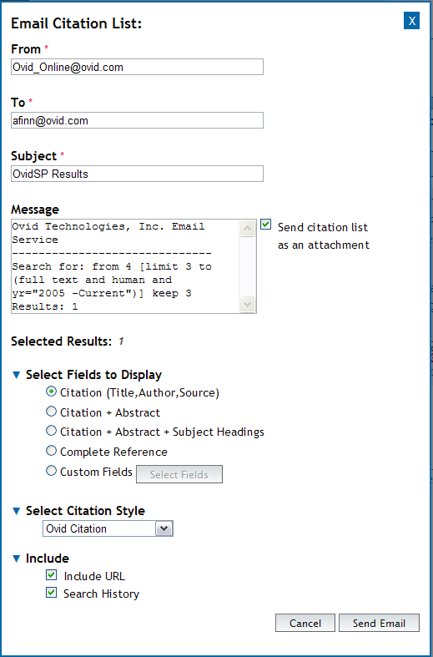
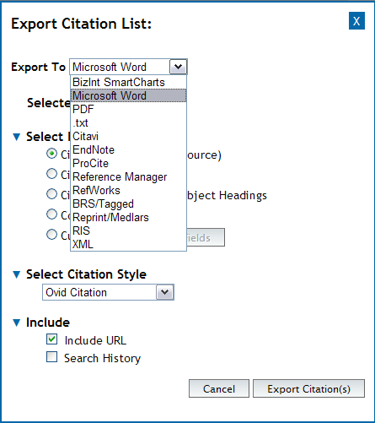
Output – Print/Email/Export
Notes:
Here are the output options at the top of any results page. Use Export for Word Processing and Reference Management – EndNote, Procyte, Ref Works etc. The Excel output format may be useful for analysis and is also available at an alerting output format.

Slide 25
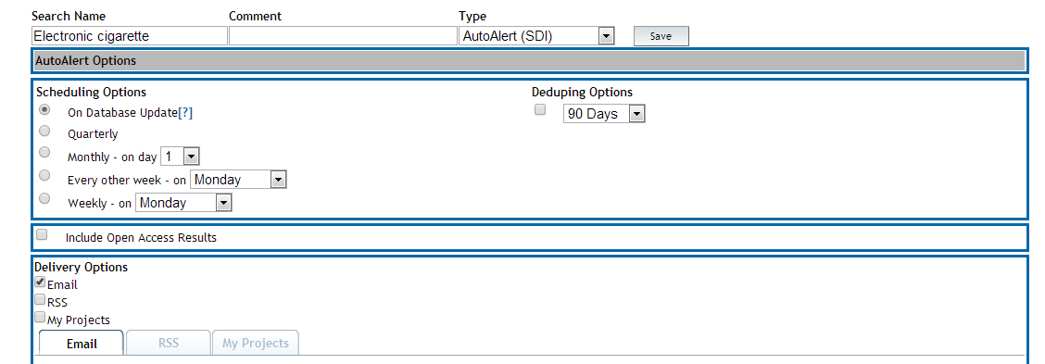
Next Steps
As well as saving or outputting results, results may be captured in a My Projects repository, or the search itself may be saved and rerun later or the search may be saved as an autoalert for current awareness.
Notes:
As well as saving or outputting results, results may be captured in a My Projects repository, or the search itself may be saved and rerun later or the search may be saved as an autoalert for current awareness.

Slide 26

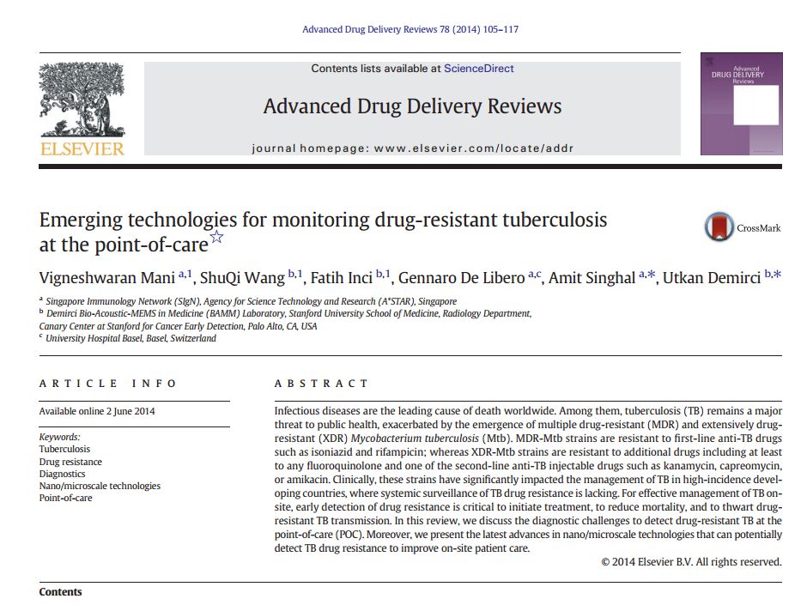
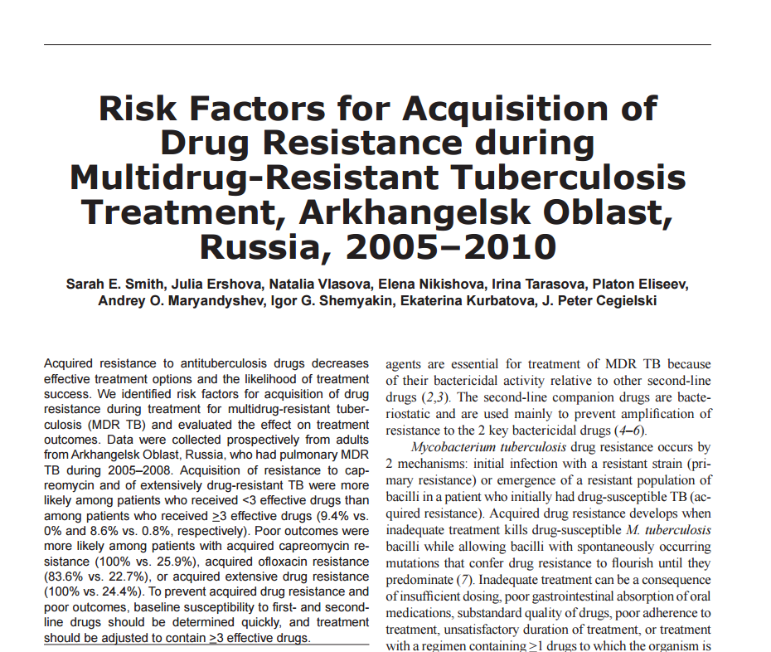
Links to Full-Text
Two Types:
Ovid Full Text – Journals@Ovid Subscriptions
Full Text – External full text both free or subscribed
Notes:
Ovid Full Text links take you from the database to your subscribed journals. Full Text links open in a new window with a new session for access to an article, links are often also available for other types of publications

Slide 27
Thank you
For further information contact
E-mail: support@ovid.com
Phone: +44 (0) 203 197 6660

