Slide 1
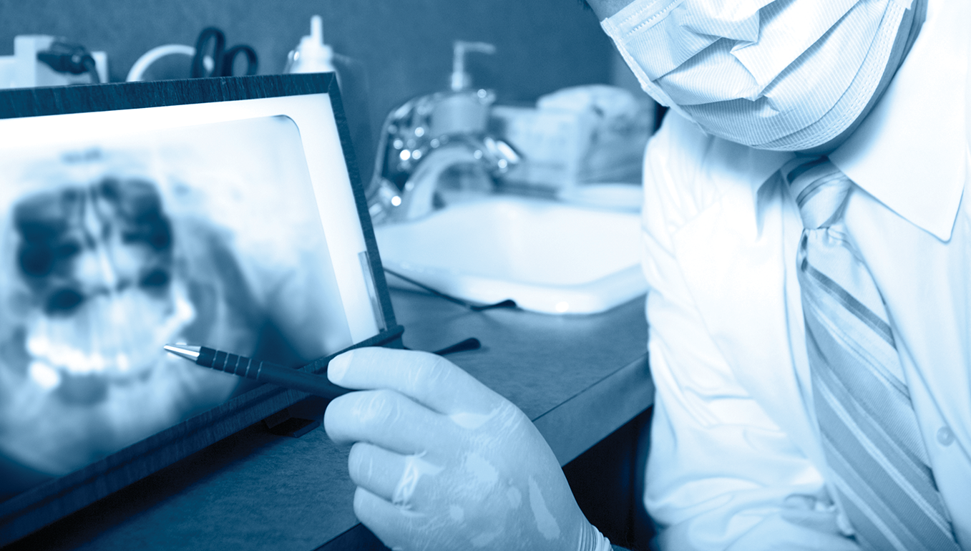
SUBTITLE

Slide 2
COVERING ALL AREAS OF DENTISTRY
General Dentistry
Aesthetic Dentistry
Dental Anaesthesiology
Dental Public Health
Endodontics
Forensic Odontology
Geriatric Dentistry
Oral and Maxillofacial Pathology
Oral and Maxillofacial Radiology
Oral and Maxillofacial Surgery
Orthodontics and Dentofacial Orthopedics
Periodontics
Pediatric Dentistry
Prosthodontics

Slide 3
Is Dentistry & Oral Sciences Source the place dental researchers should begin their research?

Slide 4
None of the following journals are indexed in MEDLINE, but ALL are indexed via Dentistry & Oral Sciences Source
Australasian Dental Practice
Brazilian Journal of Oral Sciences
China Journal of Oral & Maxillofacial Surgery
Columbia Dental Review
Endodontic Practice Today
Hellenic Orthodontic Review
International Dental Research
International Journal of Medical Dentistry
Journal of International Dental & Medical Research
Oral Surgery
Orthodontic Products
Quintessence of Dental Technology (QDT)
Revista Española de Cirugía Oral y Maxilofacial
Revista Odonto Ciencia
Revista Oral
Romanian Journal of Stomatology
Virtual Journal of Orthodontics

Slide 5
Sample Comparison of Shared Journals Indexed in Both MEDLINE and Dentistry & Oral Sciences Source
PUBLICATION NAME | Total Articles indexed in MEDLINE (1/2000 to 3/2018) | Total Articles indexed in DOSS (1/2000 to 3/2018)
CDS Review | 863 | 1,822
Dental Press Journal of Orthodontics | 482 | 936
Dental Traumatology | 1,454 | 1,550
European Journal of Oral Sciences | 1,555 | 1,626
Gerodontology | 974 | 1,098
International Endodontic Journal | 2,378 | 2,645
International Journal of Oral & Maxillofacial Surgery | 3,641 | 5,003
International Journal of Paediatric Dentistry | 1,196 | 1,508
In addition, MEDLINE does NOT contain searchable cited references, but DOSS provides searchable cited references for more than 120 journals, including the Journal of Dental Research from 1919 to present.

Slide 6
Sample Comparison of Shared Journals Indexed in Both MEDLINE and Dentistry & Oral Sciences Source
PUBLICATION NAME | Total Articles indexed in MEDLINE (1/2000 to 9/2015) | Total Articles indexed in DOSS (1/2000 to 9/2015)
International Journal of Prosthodontics | 1,751 | 2,290
Journal of Adhesive Dentistry | 1,006 | 1,075
Journal of Dental Hygiene | 735 | 1,169
Journal of Esthetic & Restorative Dentistry | 1,053 | 1,225
Journal of Evidence-Based Dental Practice | 1,024 | 1,318
Journal of Oral Rehabilitation | 2,412 | 2,499
Journal of Orofacial Pain | 519 | 695
In addition, MEDLINE does NOT contain searchable cited references, but DOSS provides searchable cited references for more than 120 journals, including the Journal of Dental Research from 1919 to present.

Slide 7
Dentistry & Oral Sciences Source Searchable Cited References Uniqueness vs. Web of Science Core Collection
 | Total # of Journals
Dentistry & Oral Sciences Source Searchable Cited References | 122
Web of Science Core Collection Searchable Cited References Overlap with Dentistry & Oral Sciences Source | 62
Unique Searchable Cited References in Dentistry & Oral Sciences Source | 60
Figures as of November 2018

Slide 8
Dentistry & Oral Sciences Source Full Text Compared
FULL-TEXT SOURCES | TOTAL | UNIQUE*
Full-Text Journals & Magazines | 271 | 261
Full-Text Books & Monographs | 31 | 31
* Not available as full text in any version of Academic Search, CINAHL or MEDLINE
Figures as of November 2018

Slide 9
Eigenfactor Dentistry Journal Rankings and Dentistry & Oral Sciences Source Coverage
RANK | JOURNAL | Active Indexing & Abstracts in DOSS | Active Full Text in DOSS | Active Full Text in Any Other EBSCO Database
1 | Journal of Dental Research | YES | YES | NO
2 | Clinical Oral Implants Research | YES | YES | NO
3 | Journal of Oral & Maxillofacial Surgery | YES |  | NO
4 | Journal of Endodontics | YES |  | NO
5 | Oral Oncology | YES |  | NO
6 | Journal of Clinical Periodontology | YES |  | NO
7 | Dental Materials | YES |  | NO
8 | Journal of Periodontology | YES |  | NO
9 | Oral Surgery, Oral Medicine, Oral Pathology & Oral Radiology | YES |  | NO
Eigenfactor 2015 is the most current available as of November 2018

Slide 10
Eigenfactor Dentistry Journal Rankings and Dentistry & Oral Sciences Source Coverage
RANK | JOURNAL | Active Indexing & Abstracts in DOSS | Active Full Text in DOSS | Active Full Text in Any Other EBSCO Database
10 | American Journal of Orthodontics & Dentofacial Orthopedics | YES |  | NO
11 | Journal of Dentistry | NO |  | NO
12 | International Journal of Oral & Maxillofacial Surgery | YES |  | NO
13 | International Journal of Oral & Maxillofacial Implants | YES | YES | NO
14 | Clinical Oral Investigations | YES | YES | NO
15 | International Endodontic Journal | YES | YES | NO
16 | Clinical Implant Dentistry & Related Research | YES | YES | NO
17 | Archives of Oral Biology | YES |  | NO
Eigenfactor 2015 is the most current available as of November 2018

Slide 11
Eigenfactor Dentistry Journal Rankings and Dentistry & Oral Sciences Source Coverage
RANK | JOURNAL | Active Indexing & Abstracts in DOSS | Active Full Text in DOSS | Active Full Text in Any Other EBSCO Database
18 | Angle Orthodontist | YES | YES | NO
19 | Journal of Cranio-Maxillofacial Surgery | YES |  | NO
20 | British Journal of Oral & Maxillofacial Surgery | YES |  | NO
21 | Oral Diseases | YES | YES | NO
22 | Journal of the American Dental Association | YES | YES | NO
23 | Journal of Oral Rehabilitation | YES | YES | NO
24 | Journal of Periodontal Research | YES | YES | NO
25 | European Journal of Oral Sciences | YES | YES | NO
Eigenfactor 2015 is the most current available as of November 2018

Slide 12
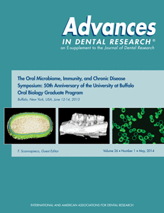
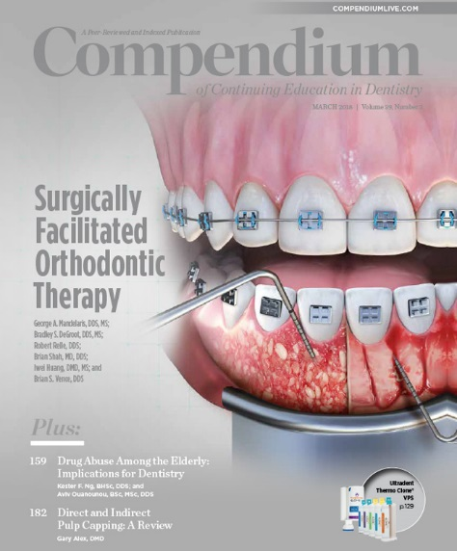
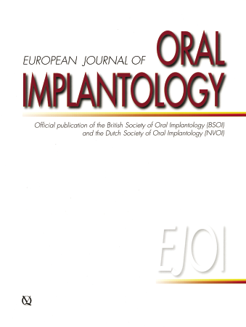
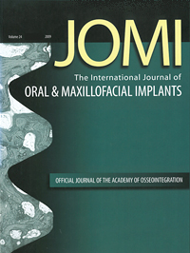
Strong Collection of Many Full-Text Journals with NO Embargo, including:

Slide 13
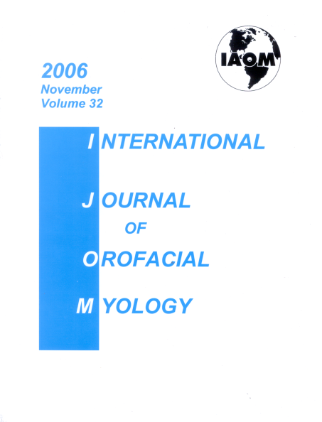
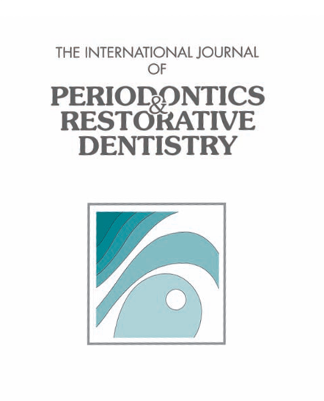
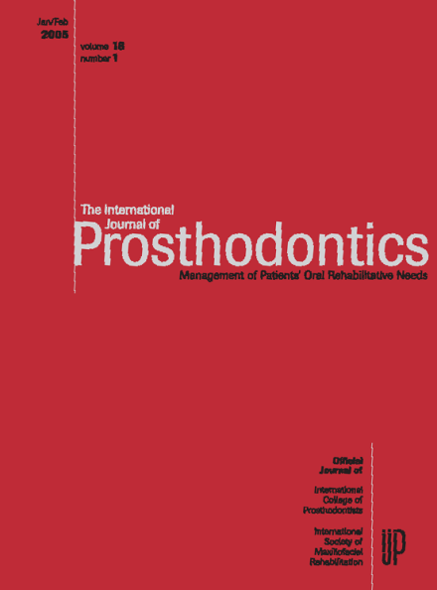
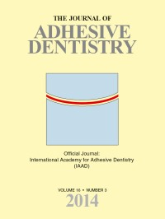
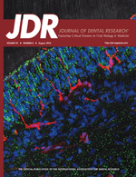
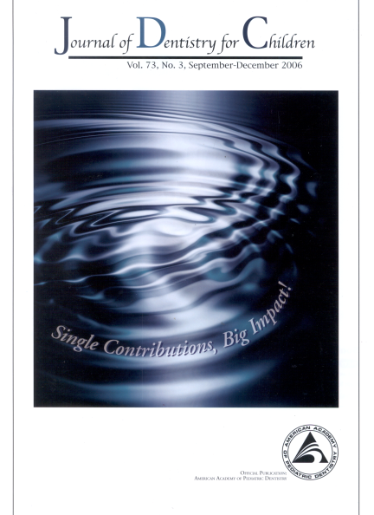
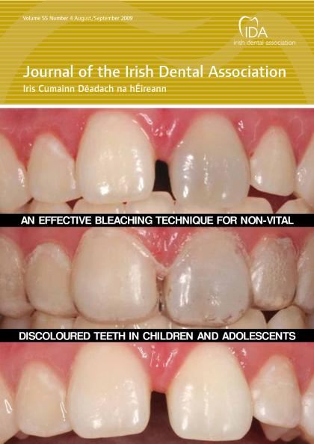
Strong Collection of Many Full-Text Journals with NO Embargo, including:

Slide 14
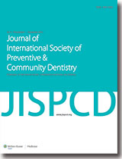
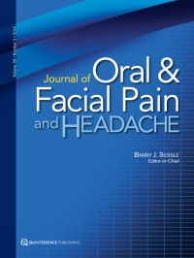
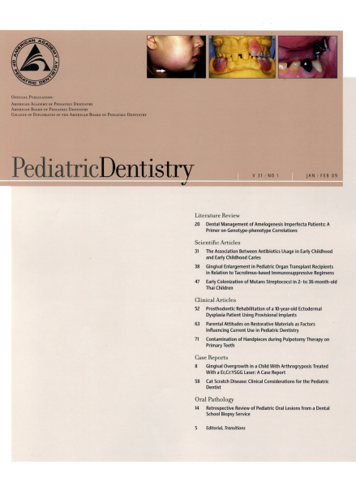
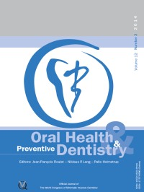
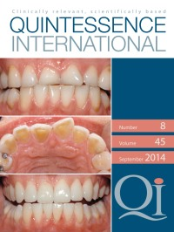
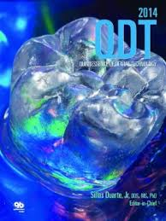
Strong Collection of Many Full-Text Journals with NO Embargo, including:

Slide 15
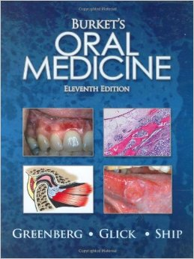
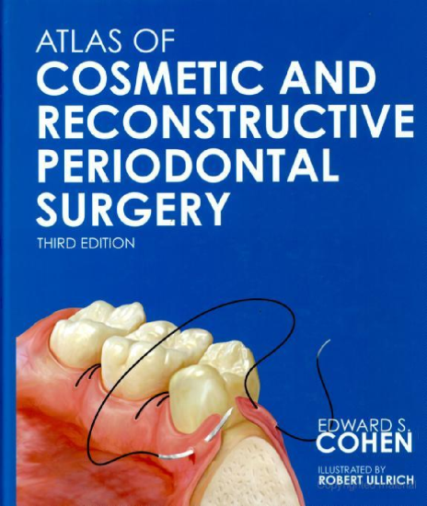
Dentistry & Oral Sciences Full-Text Books & Monographs
Atlas of Cosmetic & Reconstructive Periodontal Surgery
Burket’s Oral Medicine, Diagnosis & Treatment
Clinical Outline of Oral Pathology
Clinician’s Guide to Treatment of HIV-Infected Patients
Critical Decisions in Periodontology
Endodontics
Essentials of Oral Medicine
Oral Diagnosis, Oral Medicine & Treatment Planning
Oral Health in Geriatric Patients
PDQ Endodontics
PDQ Oral Disease: Diagnosis & Treatment
Peterson’s Principles of Oral & Maxillofacial Surgery
Psychology & Dentistry

Slide 16
Dentistry & Oral Sciences Source Coverage Summary
SOURCE TYPE | Indexing & Abstracts | Full Text | PDFs | Searchable Cited References
Academic Journals | 294 | 248 | 244 | 113
Books & Monographs | 31 | 31 | 31 | 0
Magazines & Trade Periodicals | 30 | 23 | 22 | 9
Total | 355 | 302 | 298 | 122
Figures as of November 2018

