Slide 1
原創性比對系統
智泉國際事業有限公司(iGroup Taiwan)
陳姚伶
Notes:
抄襲與引用一線之隔， iThenticate 為您把關 !!
「研究倫理」是研究工作的第一堂課，目的在培育研究者負責任的研究行為及態度。
無論是刻意忽視或無意間犯下學術倫理的疏失，將造成:
影響自己的研究生涯或是官途
-取消碩士／博士學位/官位
-取消/追回研究經費
-原作者有可能提出法律告訴
破壞我國在國際上的觀感
-國外知名期刊接受度和審核變嚴格

Slide 2
為何需要iThenticate
避免影響醫院的聲譽
符合醫院評鑑之倫理規範
作為院內研究獎勵制度之審核工具之一
作為院內同仁升等制度之審核工具之一
提供院內同仁自我檢查論文原創性服務
  部分期刊會要求投稿者需檢附原創性比對報告
  降低因不當引用被期刊退稿,減少投稿往返時間

Slide 3
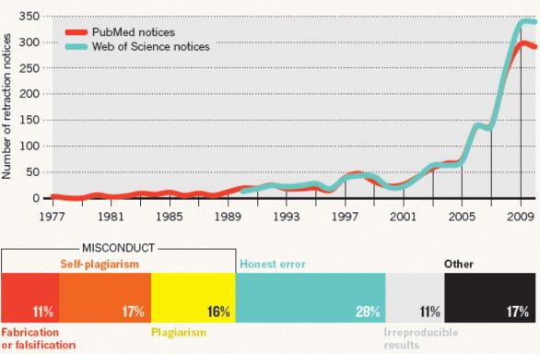
學術倫理議題日趨嚴重
因網路發達,發生不當文獻引用和抄襲調查案件日趨嚴重
Rise of the Retractions
Van Noorden. “Science publishing: The trouble with retractions” October 5, 2011. Nature. http://www.nature.com/news/2011/111005/full/478026a.html

Slide 4
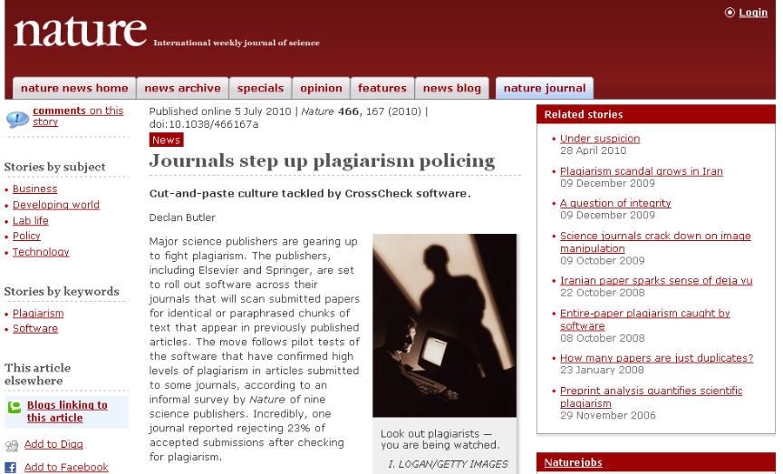
主流期刊出版社共同抵制抄襲
http://www.nature.com/news/2010/100705/full/466167a.html

Slide 5
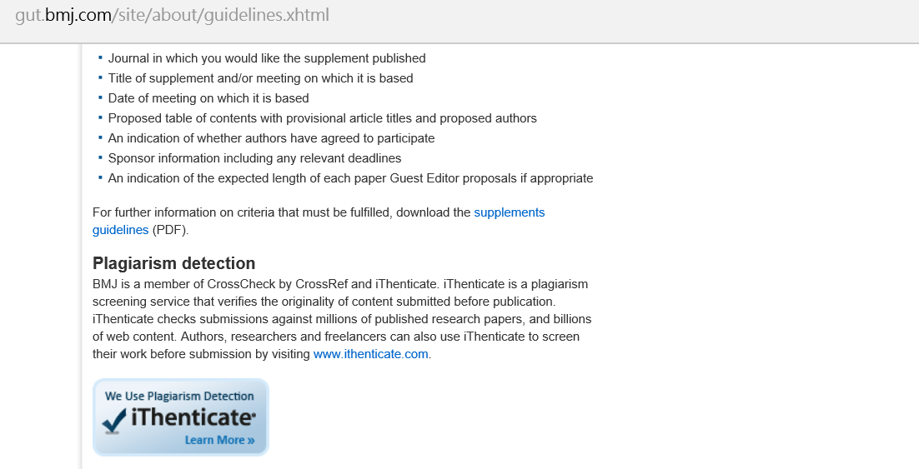
使用iThenticate為審稿工具之出版社
例: BMJ-Gut
http://gut.bmj.com/site/about/guidelines.xhtml

Slide 6
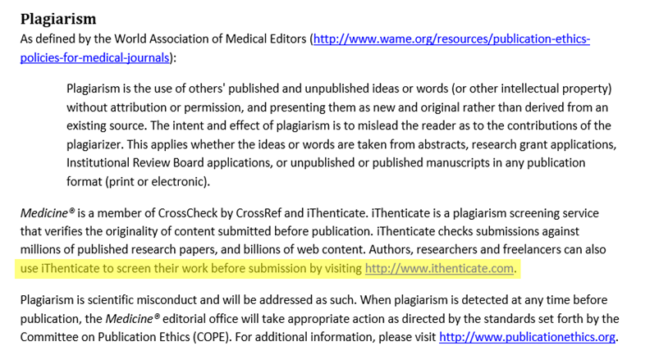
要求投稿者需檢附原創性比對報告
例: LWW Journals-Medicine
http://goo.gl/jAGF2R

Slide 7
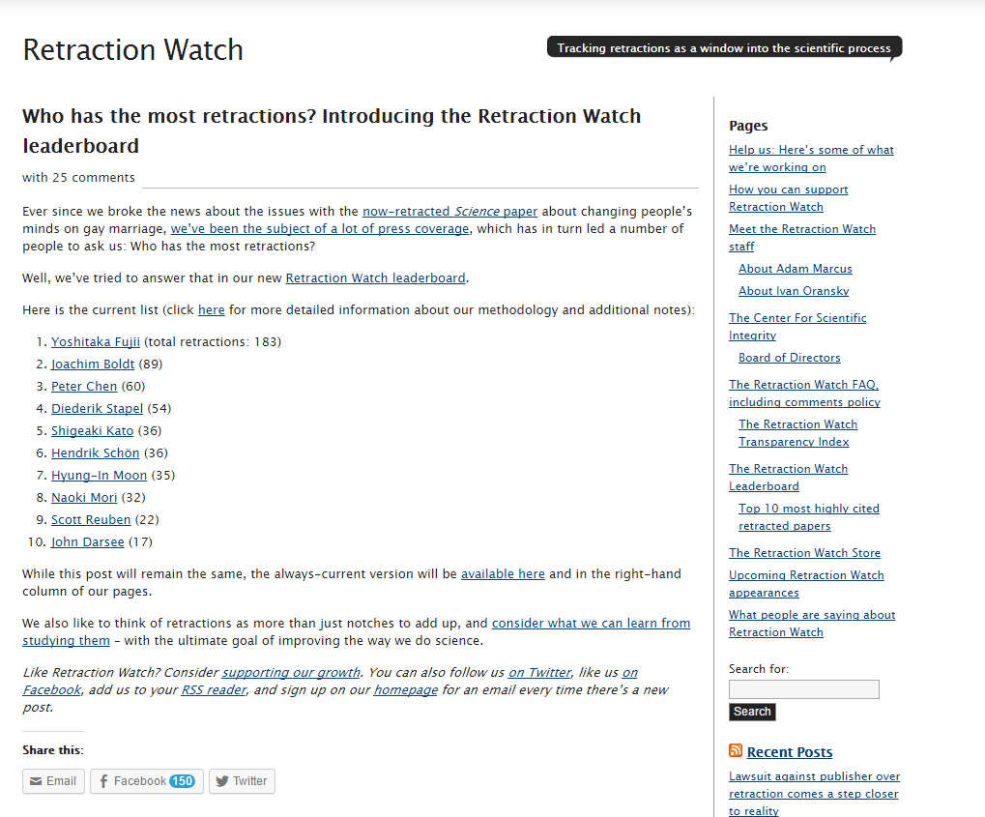
2015年期刊文章撤稿數量Top 10排行榜
❸
Notes:
美國Retraction Watch（撤銷論文觀測站）公告2015撤稿排行榜
最典型的是日本前东邦大学麻醉学者Yoshitaka Fujii，和德国前Ludwighafen医院的首席麻醉学家Joachim Boldt。
前者被撤了183篇論文,後者被撤了94篇，分别位於“排行榜”的一二名。
台灣前屏東教育大學震遠老師被撤了60篇論文排行第三名。
在被撤稿的論文中，72%被撤稿的文章由於主觀的研究錯誤，及人為造假。

Slide 8
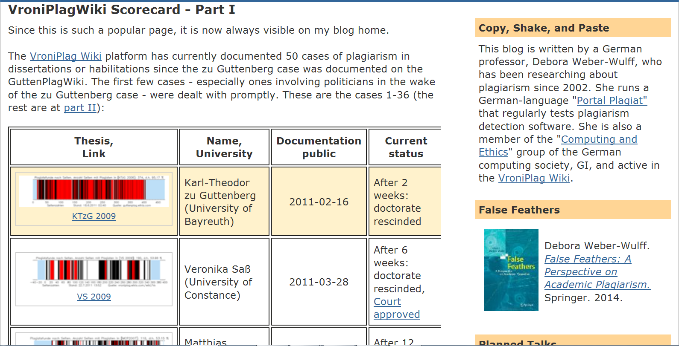

Slide 9
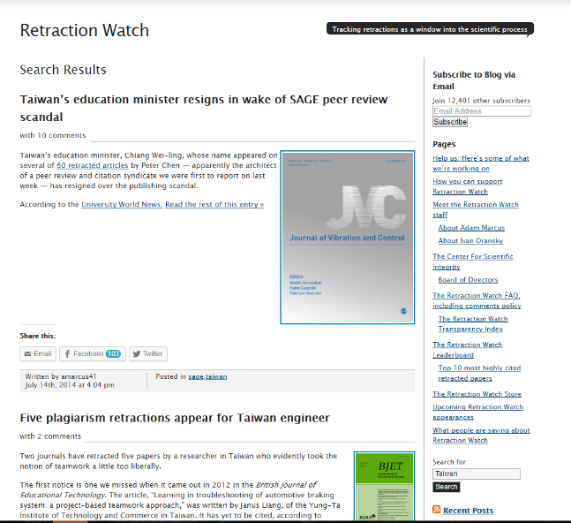
Retraction Watch（撤銷論文觀測站）

Slide 10
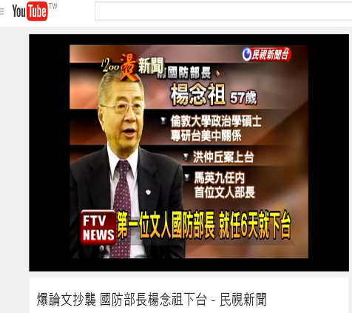
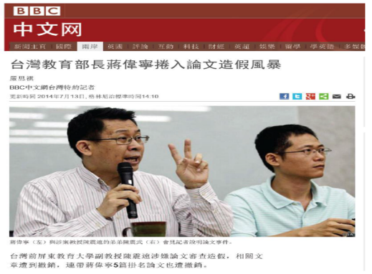
RESIGNED

Slide 11
抄襲的定義
Take and use another person's (thoughts, writings, inventions) as one's own.
The concise Oxford dictionary (6th edition), 1976) Plagiarise –
Plagiarise - To use (another person's idea or part of their work) and pretend that it is your own.
The Cambridge international dictionary of English (1995)
Plagiarise - To take somebody else’s ideas or words, and use them as if they were one's own.
The Oxford advanced learner's dictionary (5th edition) (1995)

Slide 12
COPE Flowchart
(Committee on Publication Ethics)
Complete set完整版指導方針手冊
Translations
  ENGLISH [PDF, 490KB. November 2015]
  CHINESE [All flowcharts, PDF 330KB]
What to do if you suspect plagiarism針對剽竊嫌疑如何處理
  Suspected plagiarism in a submitted manuscript [PDF, 80KB]
  Suspected plagiarism in a published manuscript [PDF, 116KB]
  http://publicationethics.org/
Notes:
The flowcharts are designed to help editors follow COPE’s Code of Conduct and implement

Slide 13
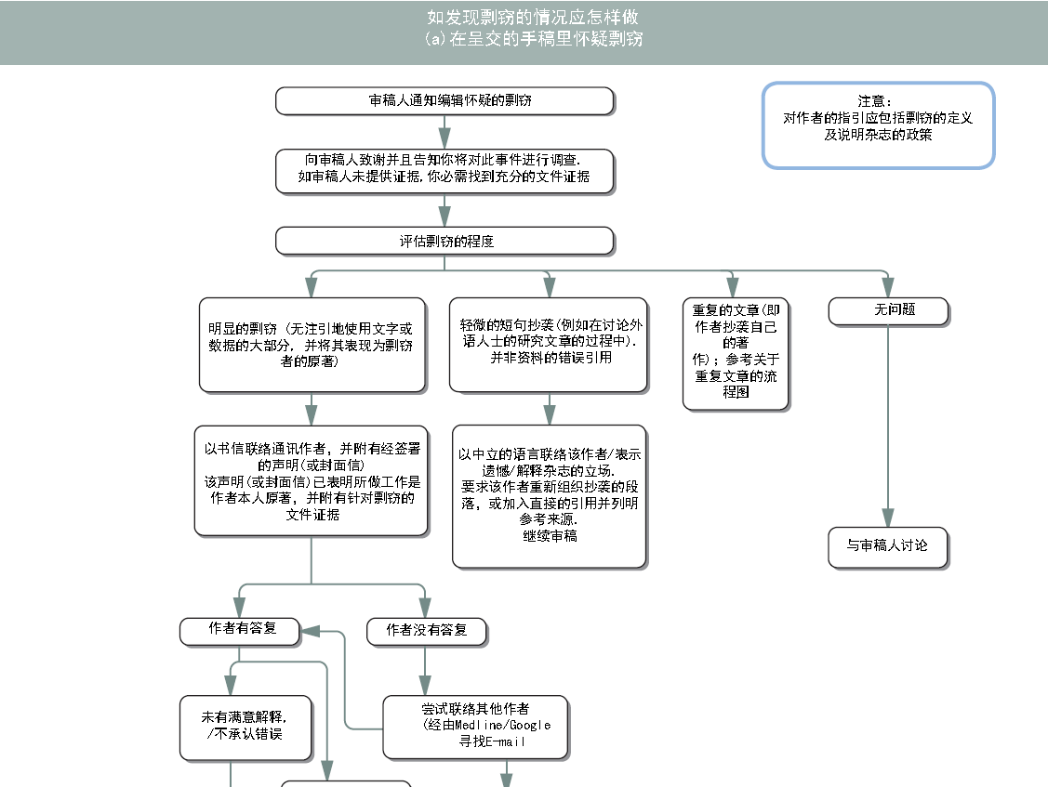

Slide 14
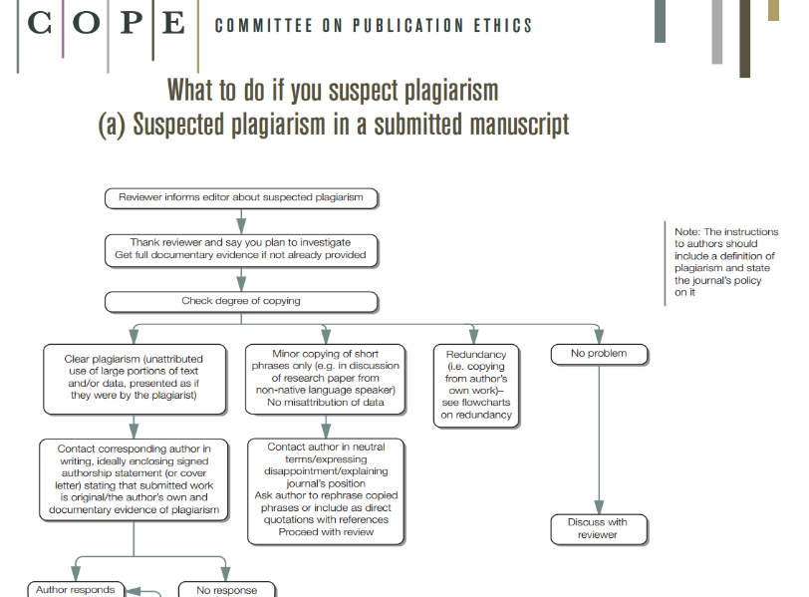

Slide 15
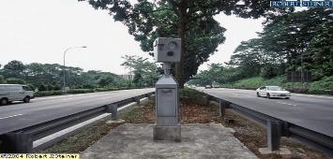
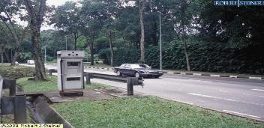
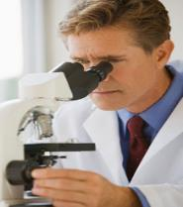
測速照相警告
A watchful eye that screens research and students’ works
© 2012 iParadigms LLC. Company confidential.

Slide 16
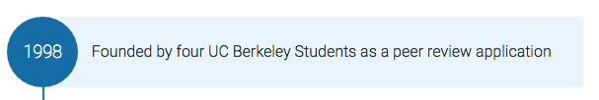





簡介
Prof. John Barrie
Notes:
The company started as a Peer Review system invented by students.

Slide 17
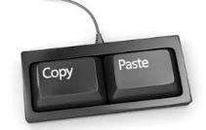


ORIGINALITY
CHECK
Two solutions…….
TWO
Solutions….

Slide 18

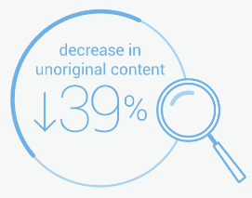
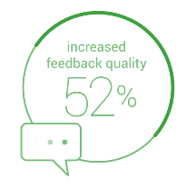
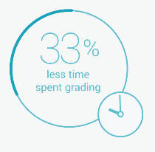
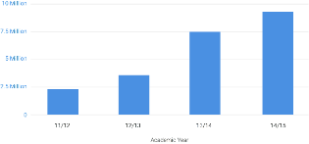
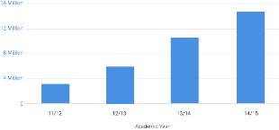

9 million papers graded 2014/15
14+ million papers graded 2014/15
World Secondary Eduction
World Higher Education
Notes:
The effectiveness of Turnitin Evaluation Space has been proven across our large user base.
Worldwide, secondary customers have reduced unoriginal content by 23% over six years of use. In higher education they have seen a 30%reduction.
In terms of online grading, secondary customers digitally marked 9 million papers in the last academic year. In higher ed, they marked 14 million papers.

Slide 19





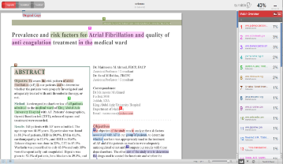
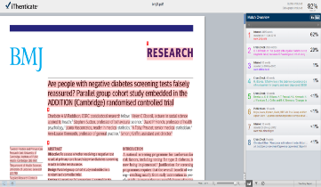
Academic
Higher Education & Further education
Publishing
Publishing, Research, Phd & Masters

Slide 20
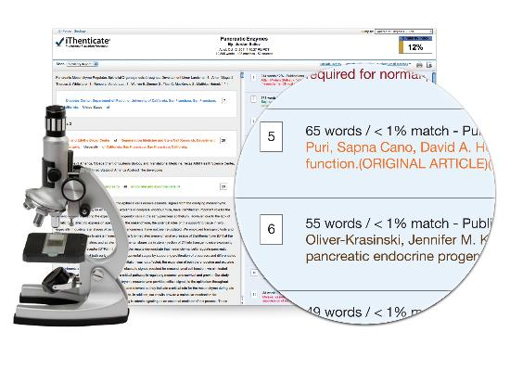
iThenticate Overview
功能目的
  預防不當引用文獻
  協助寫作編輯過程
  保護聲譽和智慧財產權
特色
  操作簡易
  報告可分享同儕
  比對文獻方便

Slide 21


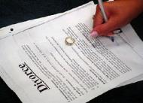
比對來源資料庫
網頁: 60+ Billion
出版社:49+ Million
平台夥伴: 105+ Million
  ProQuest博碩士論文
    從2008年收錄超過300,000+ 博碩士論文
http://www.ithenticate.com/content

Slide 22








與領導權威的學術出版社共同合作
590+ leading scientific, technical and medical (STM) publishers, including: AAAS, ACS, ACM, BMJ Publishing Group, Elsevier, IEEE, Nature Publishing Group, Oxford University Press, Sage, Wiley Blackwell, Springer, Sage, Am. Institute of Physics, Am. Physical Society, ….etc
Notes:
Journal articles, conference proceedings and books via CrossCheck powered by iThenticate from 590+ leading scientific, technical and medical (STM) publishers,

Slide 23
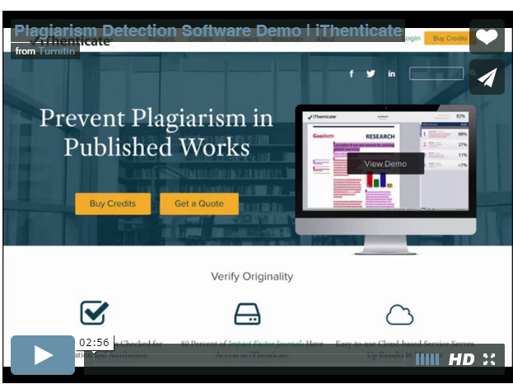
線上操作
http://www.ithenticate.com/demo

Slide 24
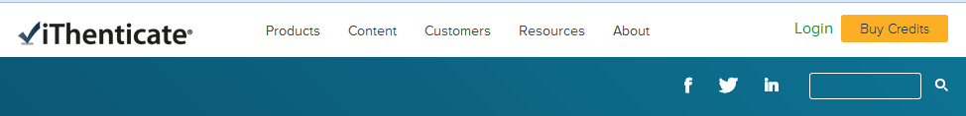
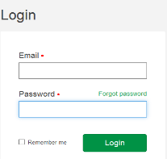
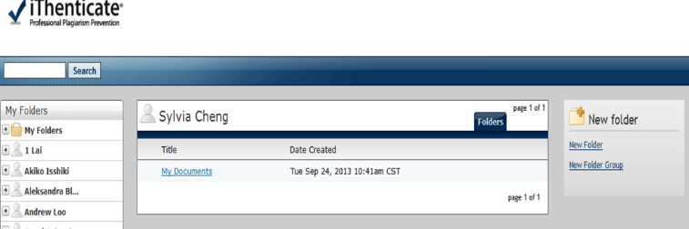
iThenticate 快速操作指南
Step 1登入帳號(email)密碼
Step 2: 新增資料夾或是資料夾群組

Slide 25
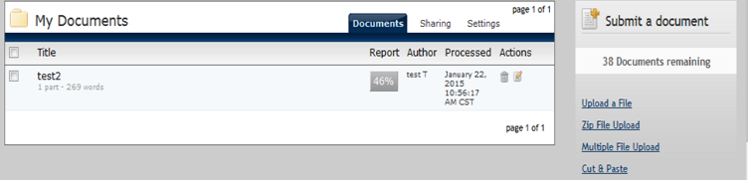
iThenticate快速操作指南
Step 3. 點選上傳文章方式(單一檔案/壓縮檔/複檔/剪貼文字)
輸入文章篇名和作者姓名,上傳電腦檔案

Slide 26
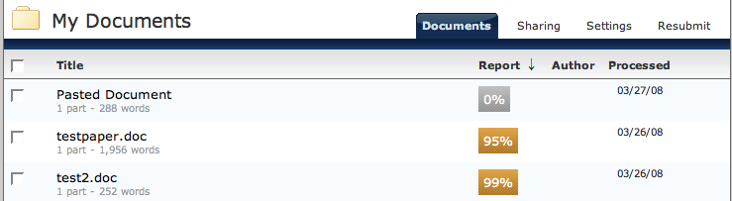
iThenticate快速操作指南
Step 4. 點選%查看原創性報告

Slide 27
瀏覽原創性報告
選擇文件報告模式Document Viewer(DV)
相似度總百分比
上傳文章相關資訊
上傳的原文
相似來源
Notes:
• paper information - the top of the report page shows information about the submitted paper. This includes the paper title, the date the report was processed, the word count, the folder the document was submitted from and the number of matching documents found in the selected databases
• paper text - the text of the submitted paper. Matching text is highlighted in a color that corresponds to the matching source listed on the right side of the Similarity Report
• matching sources - the list of matching sources for the highlighted areas within the paper text

Slide 28


文件模式Document Viewer(DV)
Match Overview:
顯示最佳化相似來源
All Sources:
顯示全部相似來源
Notes:
Match Overview (show highest matches together): A list of all areas of the paper which have similarity to information in the selected search repositories. Matches are color coded and listed from highest to lowest percentage of matching word area to the submission. Only the top or best matches are shown, all underlying matches are visible in the Match Breakdown and All Sources modes
• All Sources: Allows a user to view matches between the paper and a specific selected source in the content repositories. Contains a full list of all matches found rather than the best matches per area of similarity. This listing is exhaustive but will show all matches found, including any that are obscured in the Match Overview by virtue of being in the same or similar areas as other, better matches

Slide 29
Match Breakdown詳列各相似來源
返回Match Overview
Notes:
Match Breakdown Mode
By default the Similarity Report opens in Match Overview mode. In some cases,
matches to smaller areas of similarity may be obscured by larger matches and not
shown on this view mode. To find the underlying sources, hover over the match you
would like to view the underlying sources for and click on the arrow icon that appears.
In this mode all sources that are obscured by the selected top source are listed below
the top source. Click on a source to display the highlights for the match. The highlight
for the top source match will become lighter and the match to the selected underlying
source will be displayed with a darker highlight.
To return to the Match Overview mode click on the back arrow next to Match
Breakdown at the top of the sidebar.

Slide 30
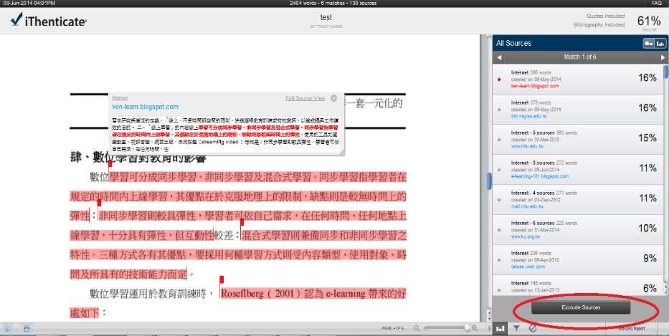
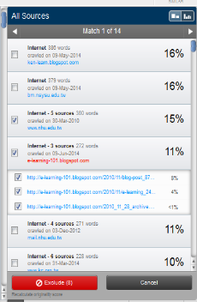
排除特定單一相似來源

Slide 31
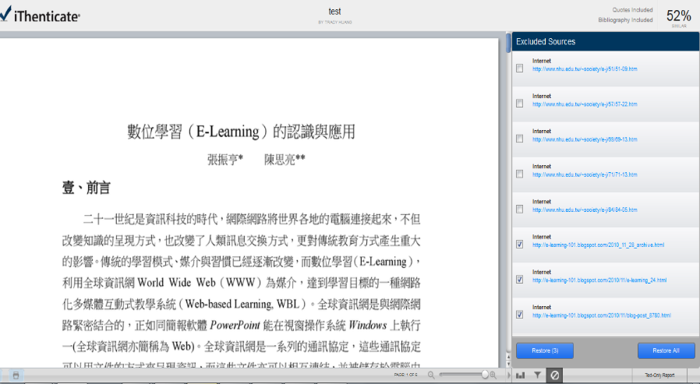
還原曾排除的相似來源

Slide 32
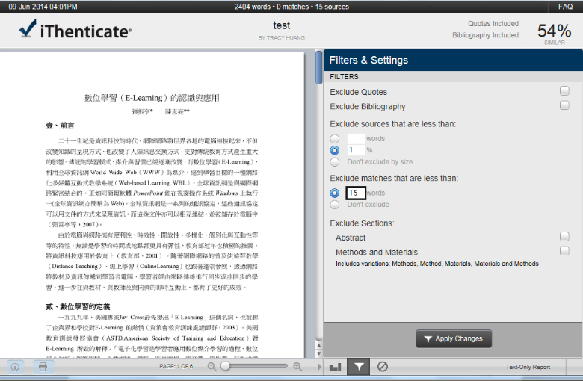
篩選設定
Notes:
"Sources" refers to a matching source and the accumulative number of matches found for that source.
"Matches" refers to single match instances that are highlighted within the document text which is a either one of many source matches or the sole match found for a source.

Slide 33
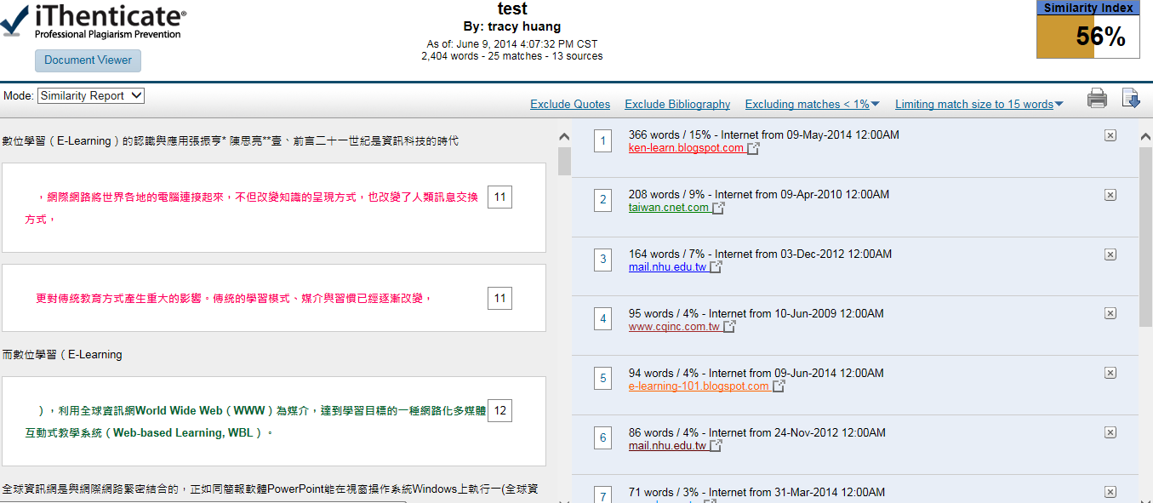
選擇純文字報告模式Text Only Report
上傳文章相關資訊
篩選工具列
上傳的原文
相似來源
排除單一相似來源
Notes:
Excluding a Match
To exclude a match, the user must open a Similarity Report and view it in the similarity report or highest matches mode.
To the right of each source listed for a match will be a gray X icon. Click on this icon to exclude

Slide 34
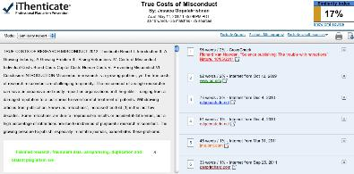
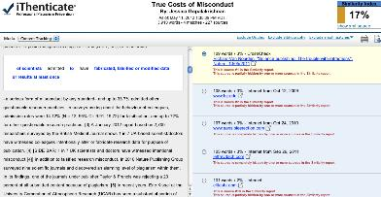
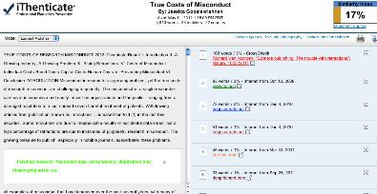
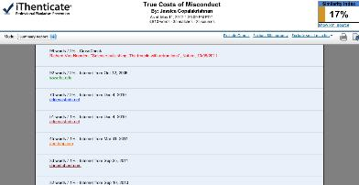
純文字報告
四種瀏覽報告方式
Similarity Report – 顯示‘相似性最佳的出處來源.
Content Tracking Report – 顯示所有相似處來源
Largest Matches Report – 顯示相似內容最多的來源.
Summary Report – 提供原創性報告綜覽,但不含原文
Notes:
• Similarity Report - this is the default viewing mode for the Similarity Report. Provides a list of all areas of the paper which have similarity to information in the iThenticate databases. Matches are color coded and listed from highest to lowest percentage of matching word area within the submission. Only the top or best matches are shown, all underlying matches are visible in the Content Tracking viewing mode. By clicking on the highlighted area of the text, the matching sources displays the actual source from the website and which part of the original writing was matched with the submitted document
• Content Tracking - the content tracking similarity report view mode lists all the matches between the databases and the submitted document. Since iThenticate updates its database regularly it may have many matches from the same source. The sources that are the same will specify when they were copied from the internet.
• Summary Report - a simple, printable list of the matches found followed by the paper with the matching areas highlighted
• Largest Matches - the report shows the percentage of words that are a part of a matching string of words (with some limited flexibility), in the Content Tracking view the report shows the percentage of matching words for a source regardless of whether or not the words are pieces of matching strings. In some cases, strings from the same source may overlap, in which case, the longer string in the Largest Match view will be displayed.

Slide 35

列印/下載原創性報告
純文字報告(Text-only Report)只提供HTML格式報告
文件報告模式(Document Viewer)只提供PDF格式報告

Slide 36
如何避免抄襲發生

Slide 37
如何避免抄襲發生
Responsible Conduct of Research (RCR),「誠實」最為重要
避免抄襲的方法：
引述、摘寫、改寫(其中的任何一種方法)
  引述(quotation)
    直接將他人論文中的文字完整放到自己的論文
    避免直接引述過多文字, 超過40個字以上要獨立分段並縮排
  摘寫(summary)
    濃縮字句，摘出原文的主要論點
  改寫(paraphrase)
    將不同出處文章整理合併，保留原論點，但加上自己的詮釋觀點
  引用(citation)
    指出原作者與出處
+ 引用
Notes:
在學術界有一種說法，英文的學術文章內文中，如果連續有7個字與另一篇文章相同，就有抄襲疑慮。但是不同學者、不同領域，對於抄襲有不同的定義，而且要看抄襲的是文字、文法，或是字詞的使用頻率等，

Slide 38
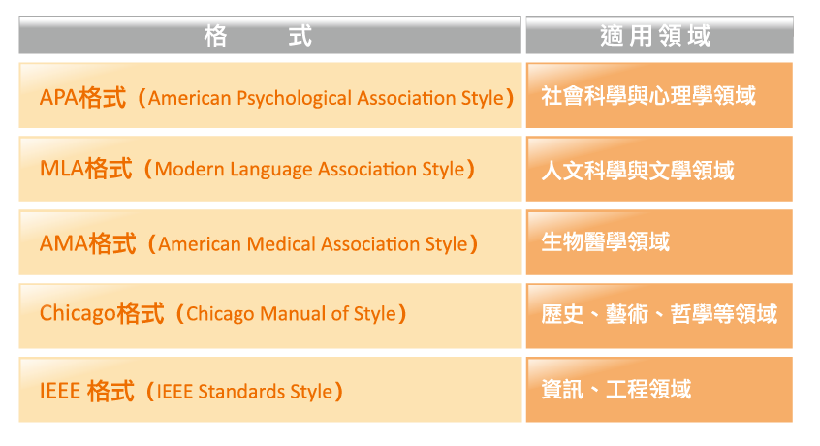
參考文獻格式
https://ethics.nctu.edu.tw/startcourse/?t=10
Notes:
要避免抄襲的第一步，就是學習相關規範與正確的寫作格式。每個領域有慣用的格式，但每本期刊仍會制定不同的參考文獻撰寫方式，因此在投稿前，仍然要參閱各期刊所制定的規範
論文寫作中，常需要引述他人的論點或文章，也是最常發生抄襲／剽竊的情況，如果要引述他人的論點或文章，在學術領域上有其引用的方法。
例如美國心理學會的規定，如果英文的引述文字在40字以內時，可直接在文章中引用，前後加上雙引號，並註明出處；如果引述超過40個字，則將其置於一個獨立方塊文內，並省略引號，從左邊縮排（American Psychological Association, 2010）。

Slide 39
引述格式
中文引述格式
英文引述格式
引述文字在40字以內時，直接在文章中引用：
  前後加單引號
  如文中已有單引號又要使用引用格式寫作時，則加雙引號
引述文字若超過40字，須放置於獨立段落：
  縮小字體
  引述文往內縮排2個字元
  前後各空一行
引述文長度不宜超過500字。
潘慧玲（編著）(2004）,教育論文格式
引述文字在40字以內時，直接在文章中引用，前後加上雙引號，並註明出處。
引述超過40字，則將其置於一個獨立方塊文內（block quotation），並省略引號，從左邊縮排。
（American Psychological Association, 2010）
https://ethics.nctu.edu.tw/startcourse/?t=10

Slide 40
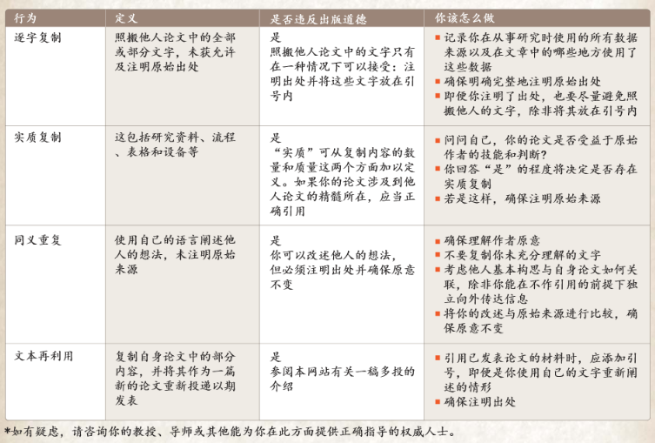
範例: Elsevier對剽竊定義和建議
http://www.elsevier.com/__data/assets/pdf_file/0009/183357/ETHICS_CH_PLA01a_updatedURL.pdf

Slide 41
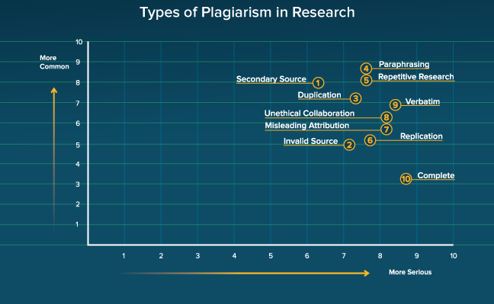
10種學術研究常見的抄襲行為
http://www.ithenticate.com/resources/infographics/types-of-plagiarism-research

Slide 42
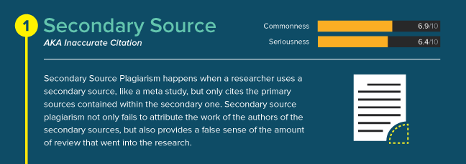
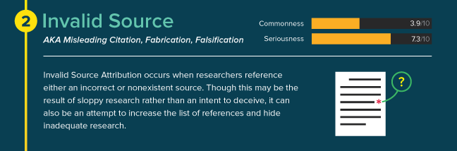
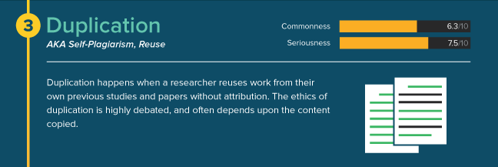

Slide 43
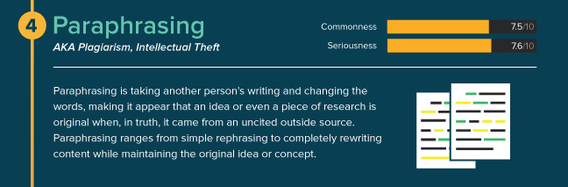
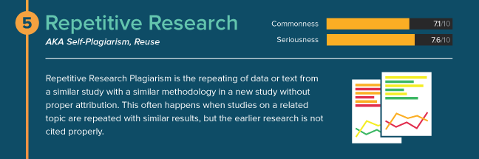
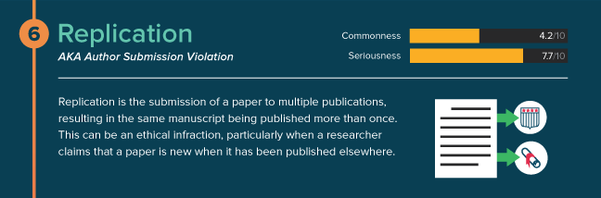

Slide 44
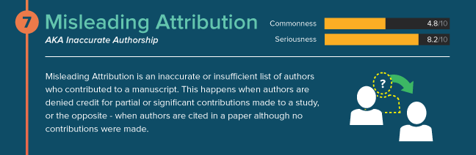



Slide 45


Slide 46

抄襲與自我剽竊定義
an article in Biochemica Medica called ‘Plagiarism and self-plagiarism: what every author should know’.
http://www.biochemia-medica.com/content/plagiarism-and-self-plagiarism-what-every-author-should-know

Slide 47
Thank
YOU
For more information, email us at service@igrouptaiwan.com
annie.chen@igrouptaiwan.com
陳姚伶 客服經理

